Slide 1
MoistMeter
Malak, Saanvi, Nathan, James

Slide 2
Problem
Agriculture industry is the biggest contributor to water footprint worldwide (Hoekstra & Mekonnen, 2012)
Traditional irrigation methods are ineffective (Levidow et al, 2014)

Slide 3
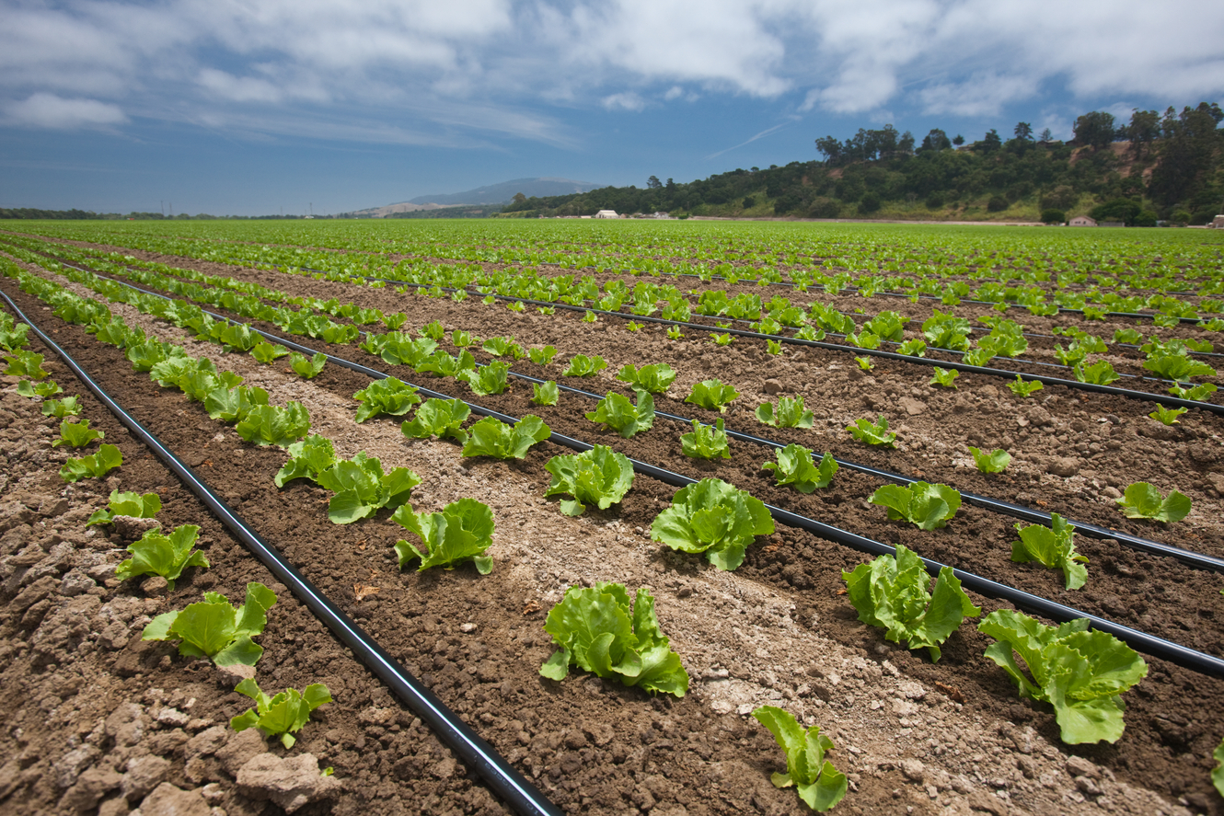

Slide 4
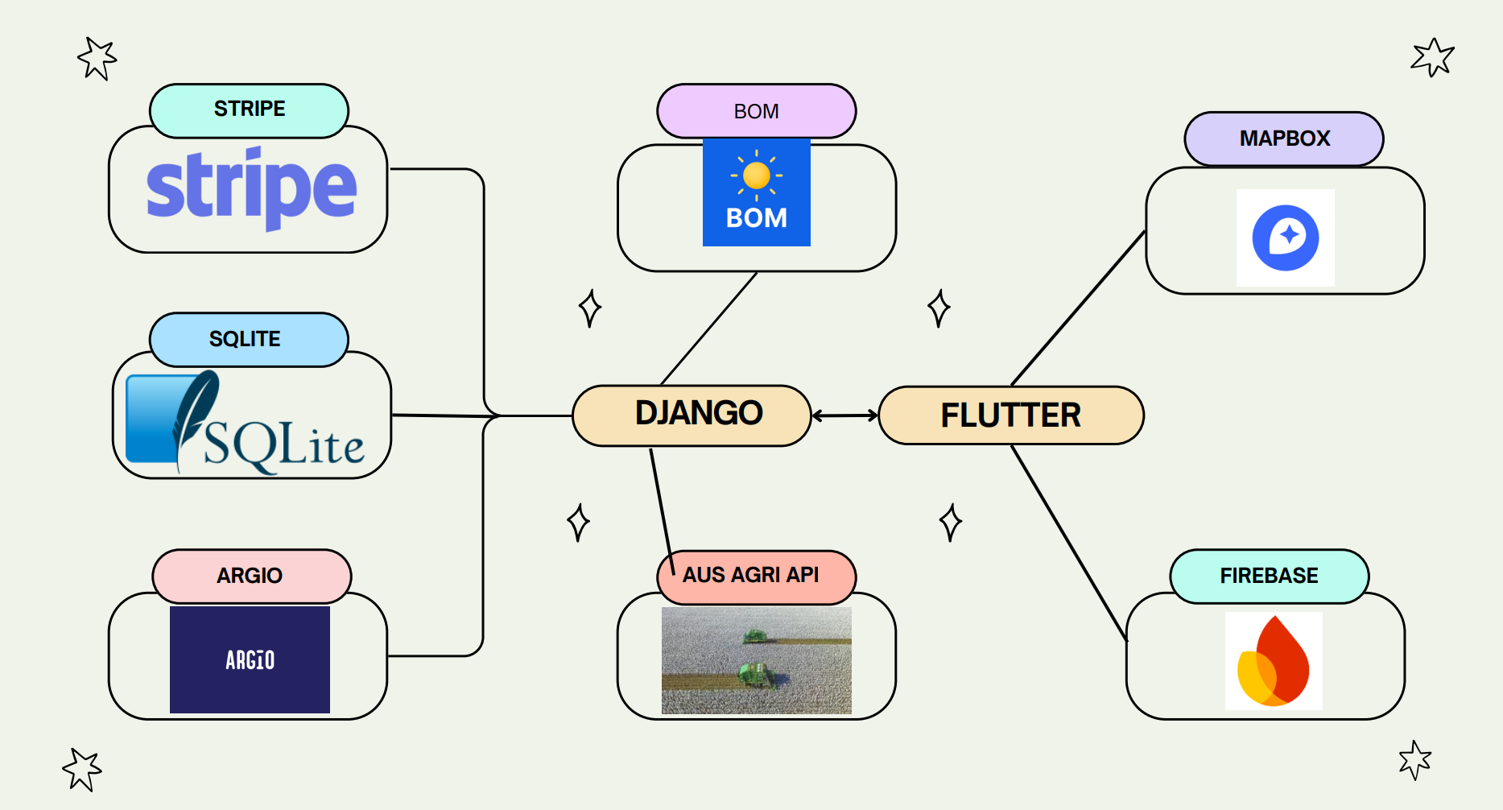
Framework

Slide 5
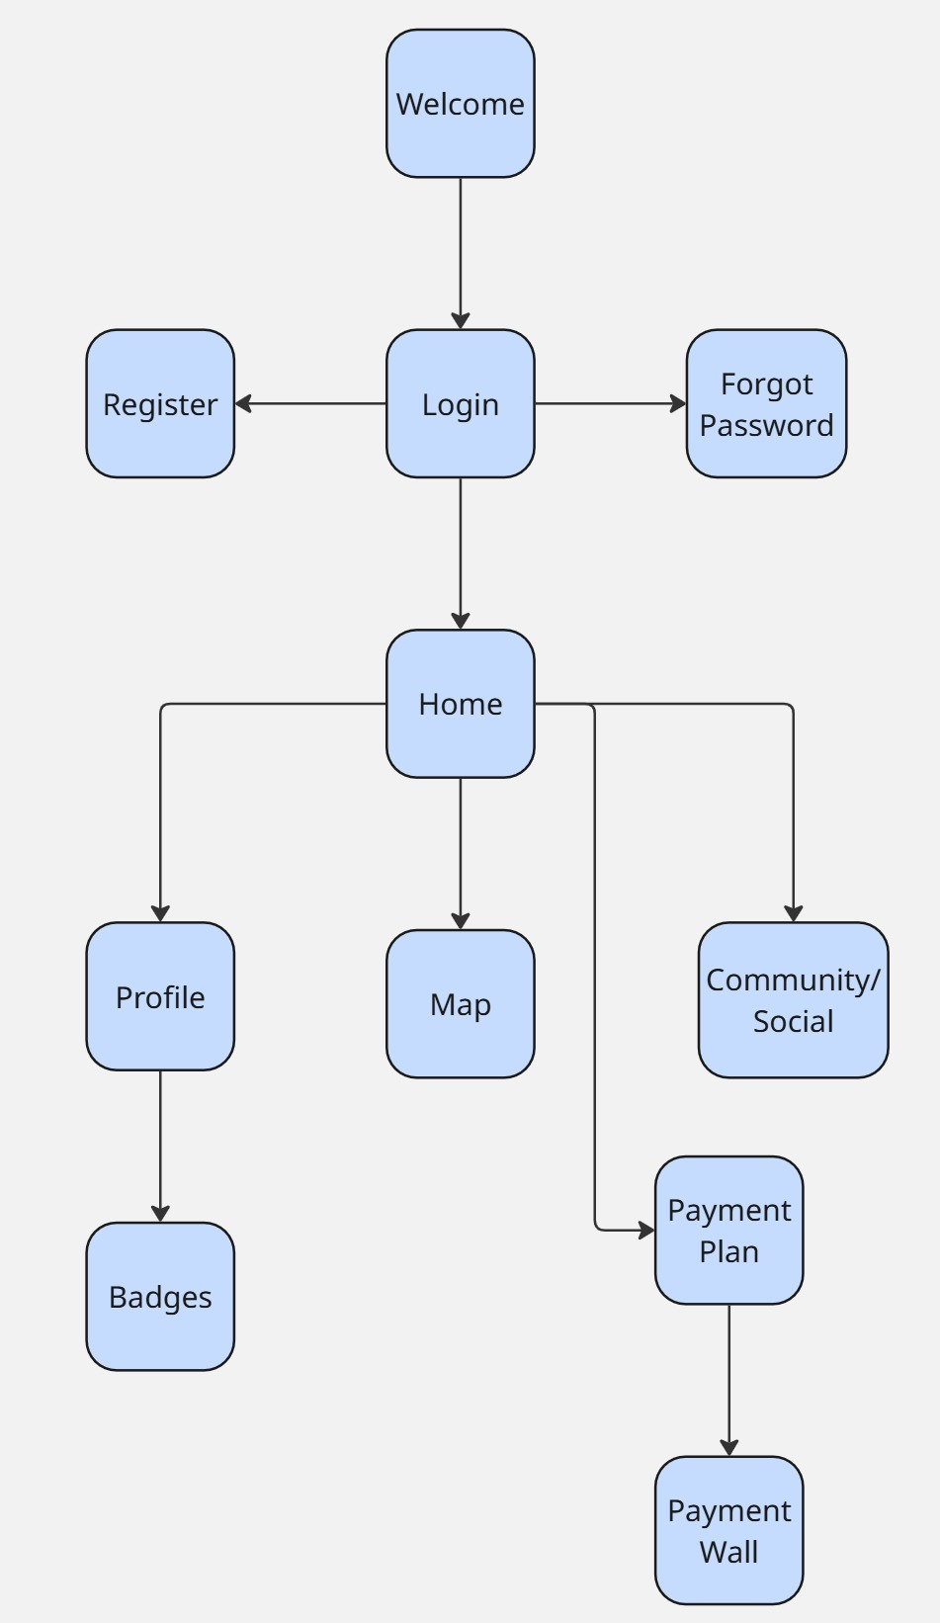
Sitemap

Slide 6
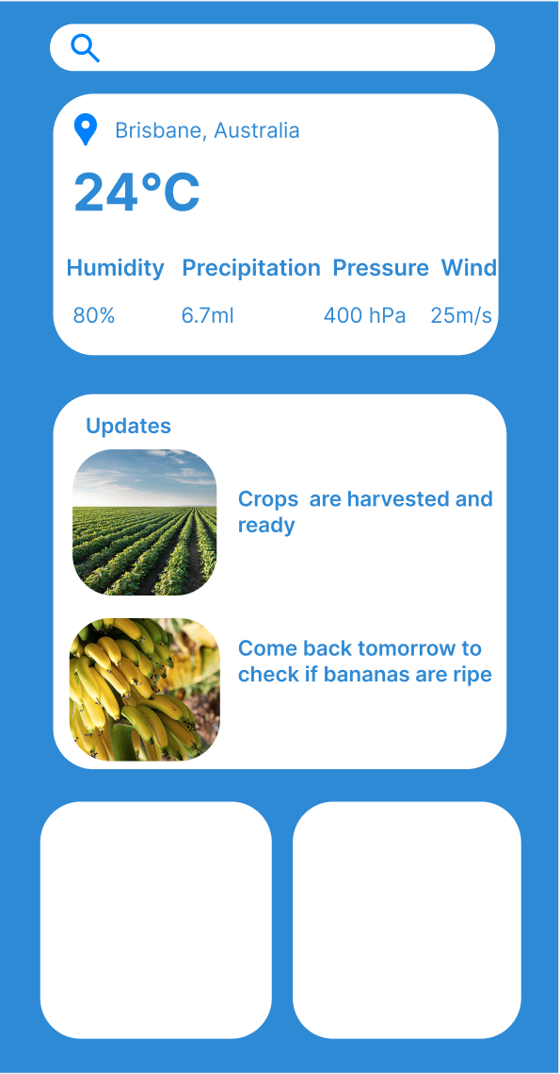



Slide 7
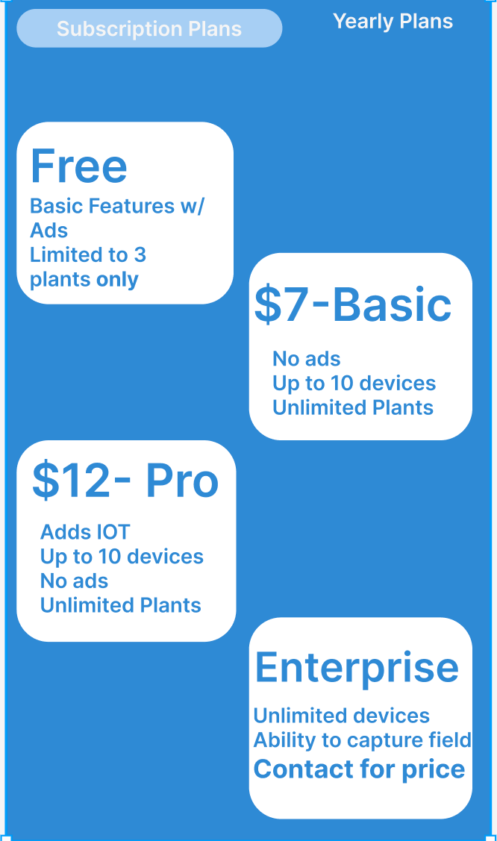
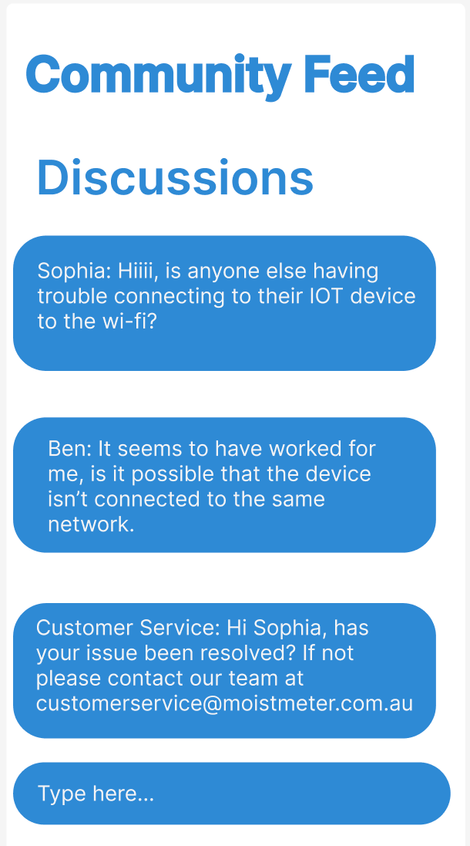
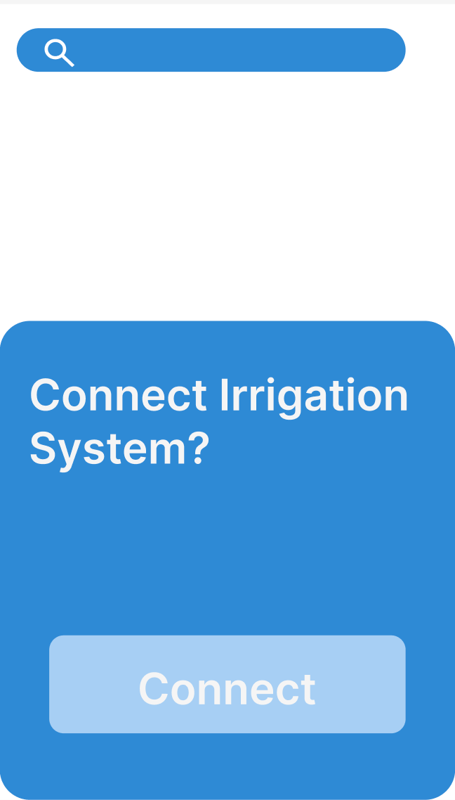

Slide 8




Platforms

Slide 9
Solution Benefits
Minimizes water needed by 45%, due to negating evaporation and transpiration losses
90% efficiency of water uptake
Intercropping can reduce green spots to 4.6% (compared to 15% in pure potato crops), and potato’s smothering effect achieving 80% weed control efficiency. (J.T. Nankar, 1990)

Slide 10
Revenue Streams
Free Version – Ads - $465 of profit per month per 1000 users Basic Version – Monthly Plan costs $6.50 to make – sells at $7- $500 of profit per month per 1000 users
Pro Version – Monthly Plan costs $7.40 to make – sells at $12 - $4600 of profit per month per 1000 users
Enterprise Version – Variable Income
Partnerships with other companies – Variable income
Estimated Yearly Profit between 12-24 months: $92 600

Slide 11
Impact
Reduces water consumption up to 52% (CQU, 2002)
Supports climate-smart agriculture
Reduces strain on freshwater resources.

Slide 12
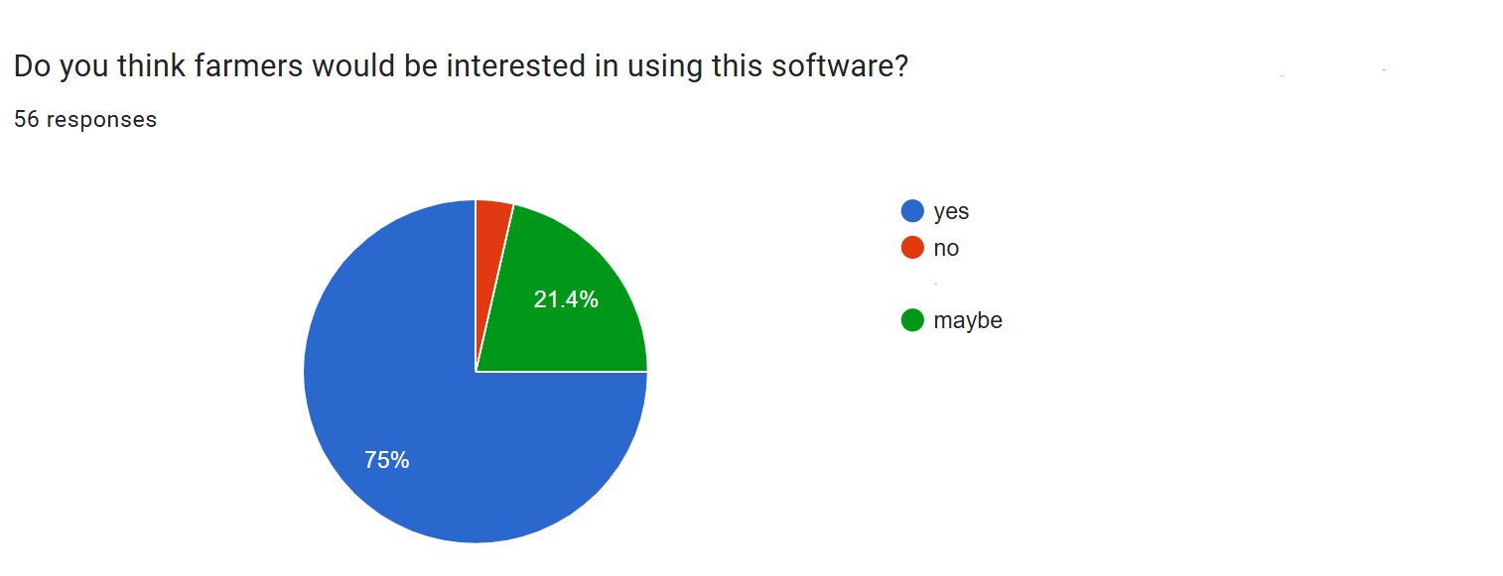
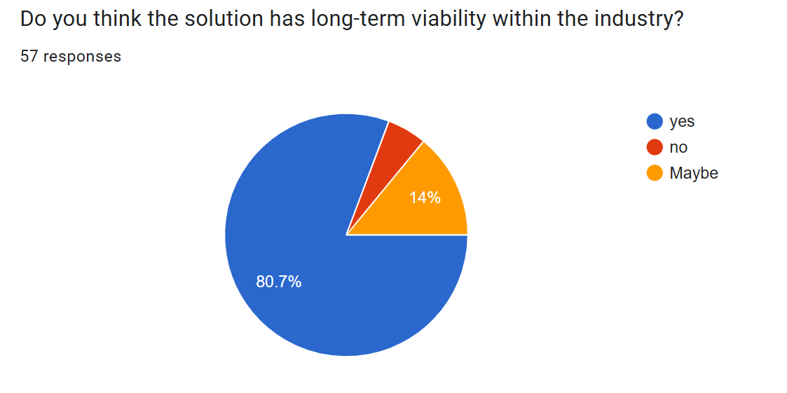
Validation
We conducted a survey that involved engineers, farmers, gardeners, computer scientists and other experts.

Slide 13


QUESTIONS?
Download Our App APK:

